Slide 1

Blood Donation Management System
"Donate blood, save lives. Be a hero in someone's story today---
INTERFACE: MYSQL
DONE BY: SENTHAMIL SELVAN

Slide 2
PROBLEM STATEMENT
1.Donor Management:
Tracking donor eligibility and donation history.
Ensuring timely reminders for eligible donors.
Verifying donor information and medical fitness.
2.Blood Request Management:
Processing blood requests from hospitals and individuals.
Prioritizing urgent requests and matching them with available blood.
Notifying hospitals and individuals about the status of their requests.
3.Blood Stock Management:
Monitoring blood stock levels at various hospitals.
Ensuring adequate supply of different blood groups.
Efficiently allocating blood to fulfill requests.

Slide 3

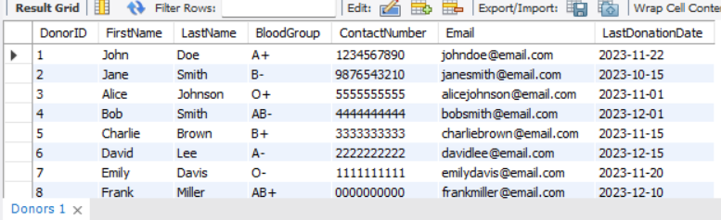
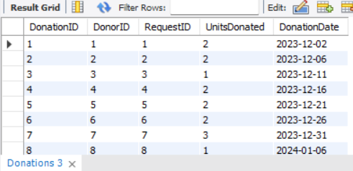
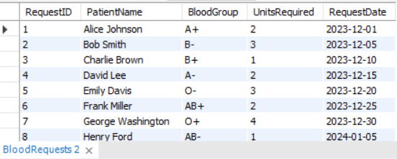
Donors, BloodRequests, Donations

Slide 4
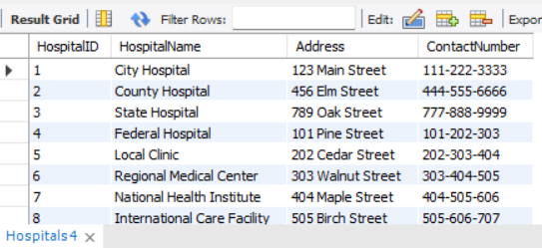
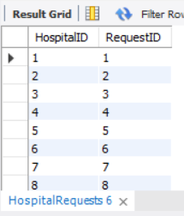
Hospitals, HospitalRequests

Slide 5
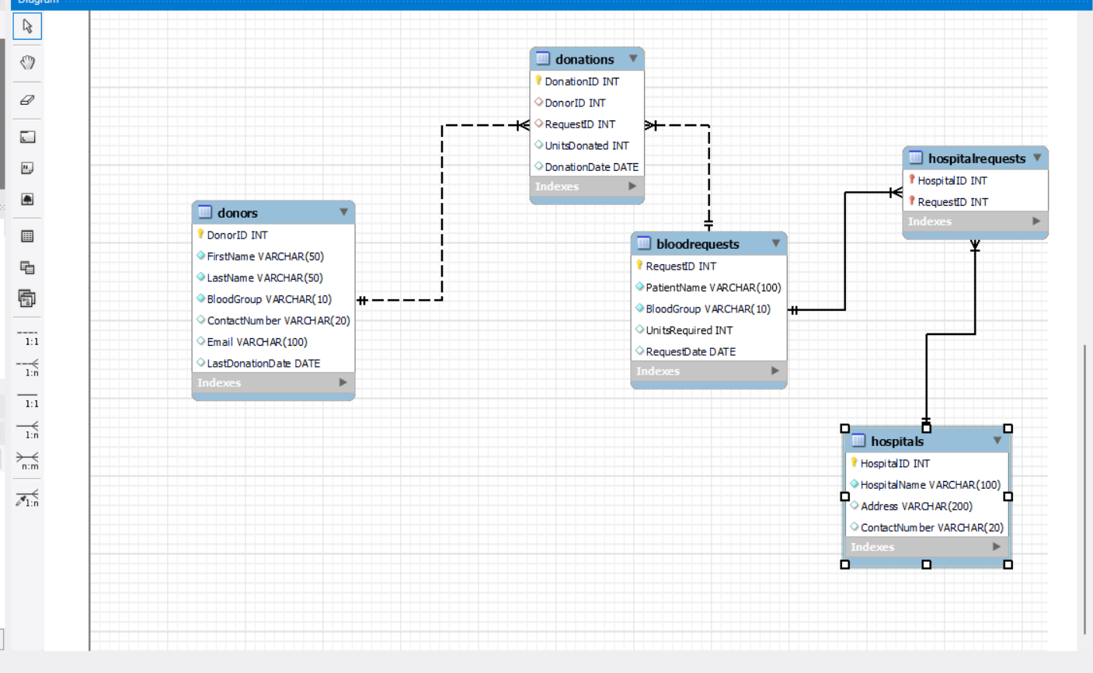
The ER-Diagram

Slide 6
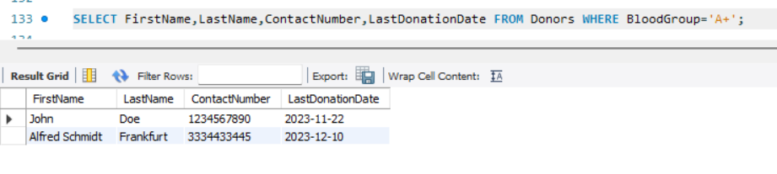
Get All Doners From The Blood Group A+

Slide 7
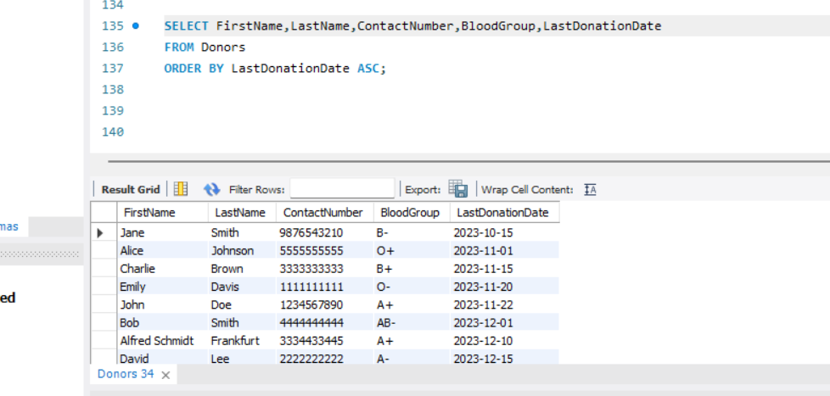
Get All Doners Order By LastDonation Date In ASC Order

Slide 8
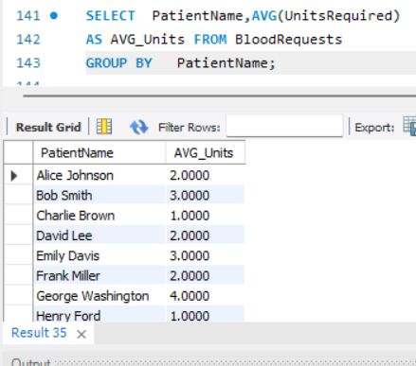
Get All patient Name And How Much Avg Unit Blood Want For Per Patients

Slide 9
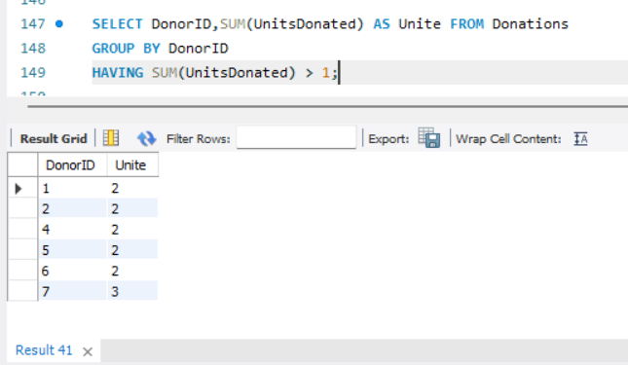
Get Doner ID And SUM Of Who Donate Greater Than 1 Unite

Slide 10
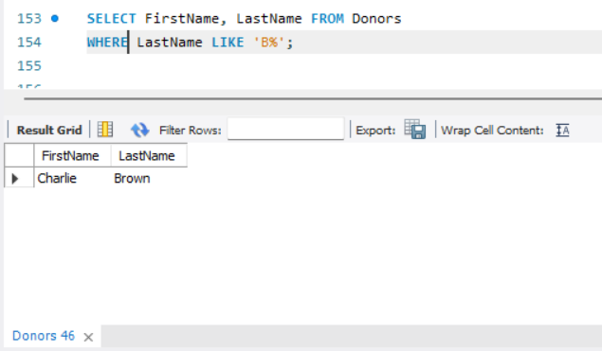
Get Doner Name Who’s LastName Start With ‘B’

Slide 11
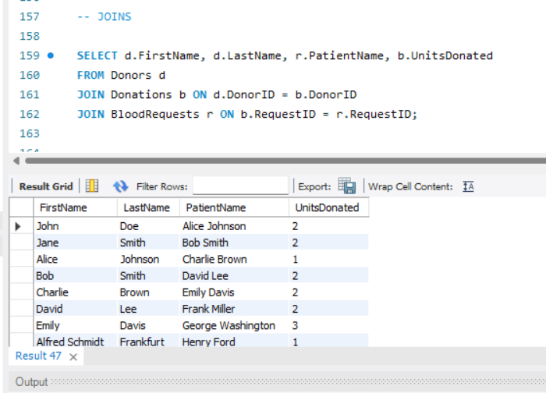
Get a List of Patients And Their UniteDonated

Slide 12
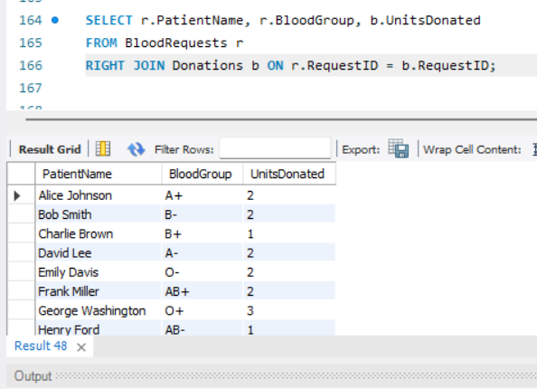
Show All Patients And Their UniteDonated Inclued BloodGroups

Slide 13
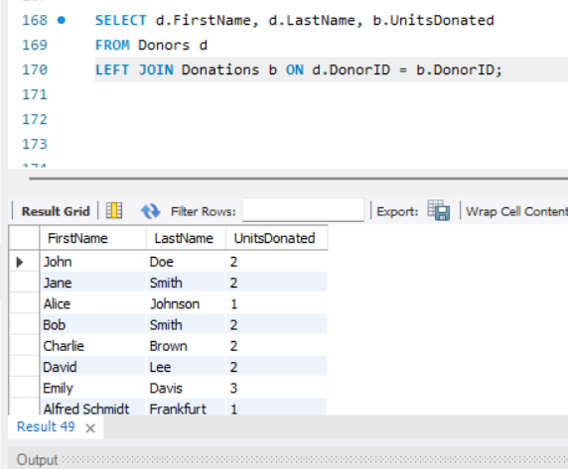
Show All Patients Name And Their Blood UniteDonated of They Donate

Slide 14
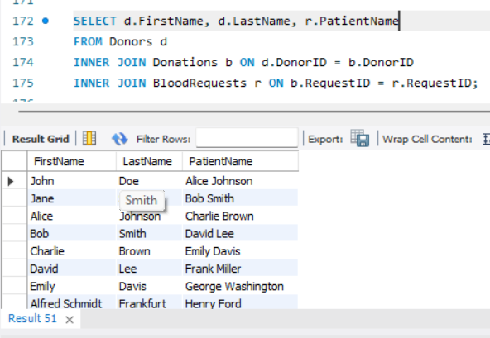
Show All Patients Name And Their Doner’s using Inner Join

Slide 15
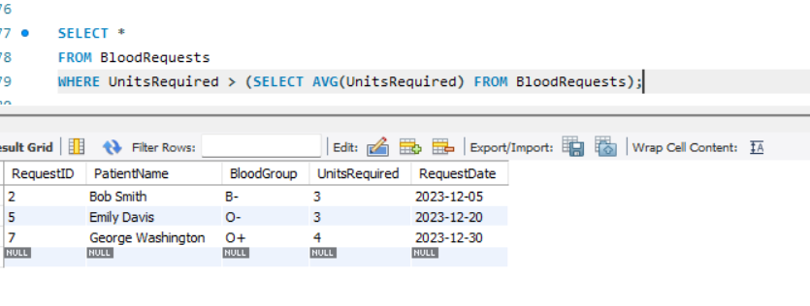
Get Blood Request Who Are Want More Avg UniteRequired With Request Date

Slide 16
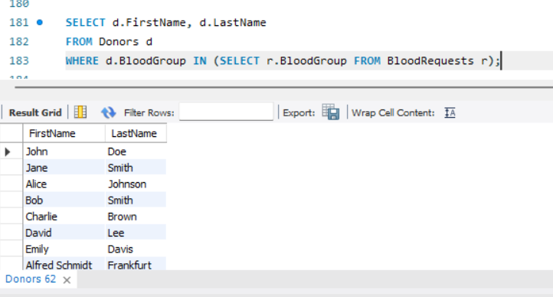
Get Frist Name and Last Name Who’s Name In Bloodgroup And Blood Req

Slide 17
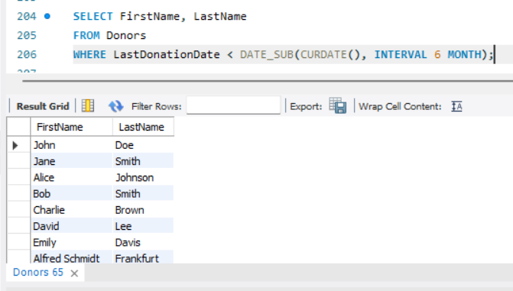
Find Doner Who Have Not Doneted In Last 6 Months

Slide 18
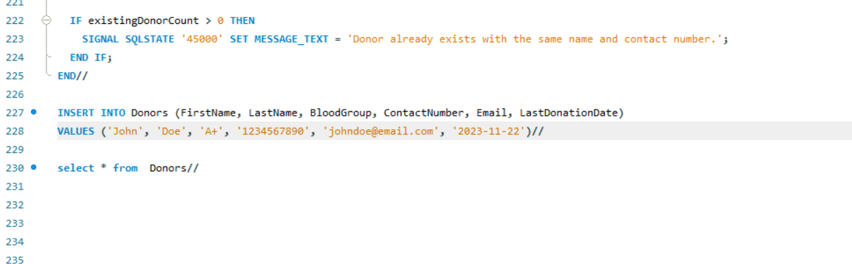
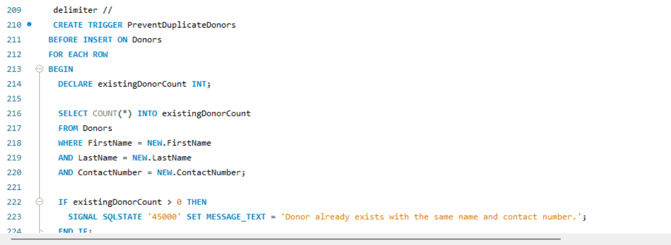
To Prevent Duplicate Donors With Trigger
OUTPUTT

Slide 19
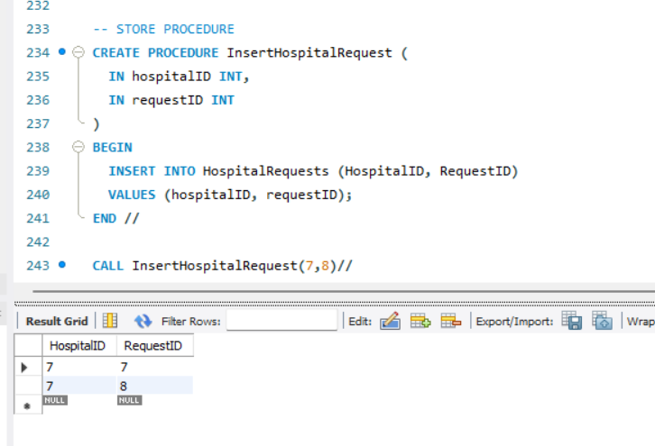
You can call these stored procedures from your application code or directly within SQL queries.

Slide 20
THANK YOU

